Slide 1
Antiochian House of Studies
CAD 5101 Leadership and Church Administration
May 4, 2023
Priest/Parish Council Relations:
How the Priest can best provide Direction and Leadership to the Parish Council
Protodeacon Peter Danilchick

Slide 2
How do our Church Governing Documents Describe the Relations between Parish, Bishop, Priest, Council?

Slide 3
How do the Parish and her Bishop relate to one another?
The Parish is the local eucharistic community of the Church
under the spiritual leadership of the local Bishop
The Bishop appoints Parish Clergy
who are accountable to him,
maintaining a relationship with them that is at once hierarchical and conciliar,
marked by obedience and collaboration.

Slide 4
What are the Parish Priest’s responsibilities?
The Priest serves as the spiritual father and teacher of the Parish.
by virtue of his ordination and canonical appointment
The Parish Priest heads and administers the Parish
exercises on its behalf the priestly duties,
shepherds the Parish entrusted to his care,
directs its orderly life
preserves its unity
keeps it faithful to its divine purpose.

Slide 5
How does the Parish and her Priest interact?
No activities in the Parish can be initiated without the Parish Priest’s knowledge, approval, and blessing
Neither should he do anything pertaining to the Parish without the knowledge of the appropriate Parish bodies
So that always and everywhere there may be mutual trust, cooperation, unity, and love.

Slide 6
What are the Parish Council’s responsibilities?
The Parish Council is a ministry that assists the Parish Priest in administration of the Parish.
seeks to foster the spiritual and material welfare of the Parish.
all those who serve are called to represent Christ to all whom they meet.
The Parish Council is responsible to the Parish Assembly and to the Bishop
conduct all Parish affairs in keeping with the mission, aims and purposes of the Church.

Slide 7
But how does this work in practice?
How do we become that local Eucharistic Community?
United around our Bishop, the Priest, the Deacons
Working together in mutual trust, collaboration, and love

Slide 8
But how does this work in practice?
How do we become that local Eucharistic Community?
United around our Bishop, the Priest, the Deacons
Working together in mutual trust, collaboration, and love
How does the Priest be the leader who…
Cares, directs, shepherds, preserves…
Keeps the community faithful to its divine purpose?

Slide 9
But how does this work in practice?
How do we become that local Eucharistic Community?
United around our Bishop, the Priest, the Deacons
Working together in mutual trust, collaboration, and love
How does the Priest be the leader who…
Cares, directs, shepherds, preserves…
Keeps the community faithful to its divine purpose?
How does the Parish Council work as a ministry?
Fostering the spiritual and material welfare of the Parish
Working together under the leadership of the Priest

Slide 10
Get Back to Basics!

Slide 11
The Sine Qua Non of Christian Leadership
Thy
Will Be
Done

Slide 12
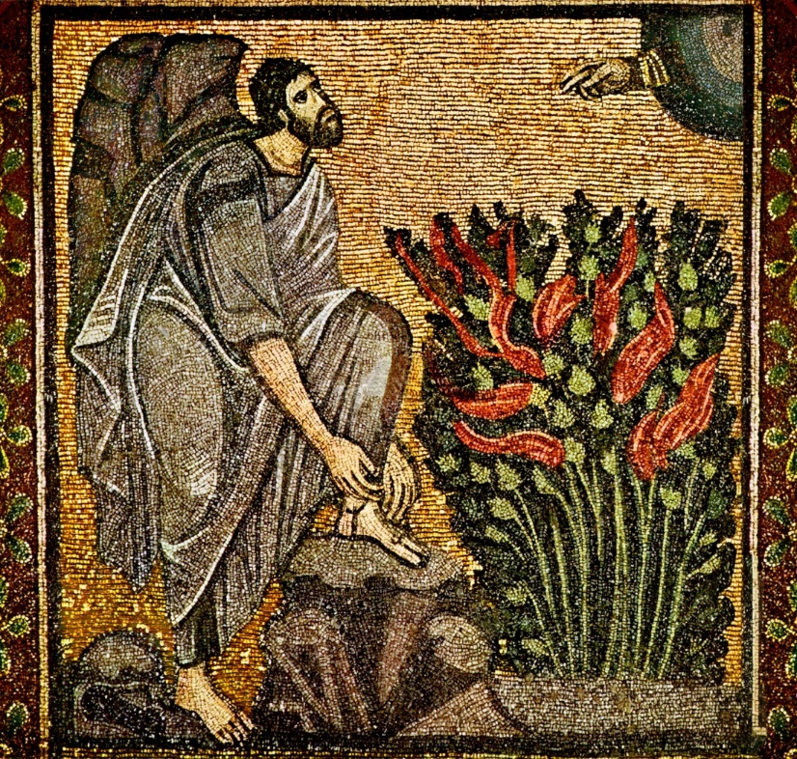
Every Parish Leader must ask:
Is the Lord God my Leader?
Moses: “What does the Lord require of you?” - Deuteronomy 10:12-13
To fear the Lord God
To walk in his ways
To love him
To serve the Lord
To keep the commandments

Slide 13
Are We Willing
to Obey His Word?
“And Simon answering said unto him, Master, we have toiled all the night, and have taken nothing: nevertheless at thy word I will let down the net.”
Luke 5:5

Slide 14
Have We Recognized
His Call as Our Leader?
“And he saith unto them, Follow me, and I will make you fishers of men. And they straightway left their nets, and followed him.”
Matthew 4:19-20

Slide 15
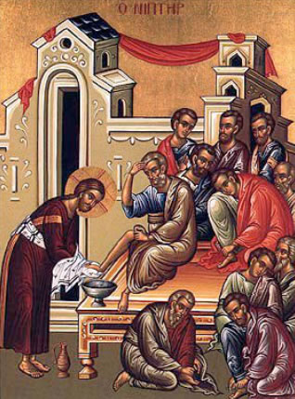
Have We Seen Our Leader
as a Servant and Followed Him?
“Now that I, your Lord and Teacher, have washed your feet, you also should wash one another’s feet.
“I have given you an example that you should do as I have done for you.”
John 13:14-14

Slide 16
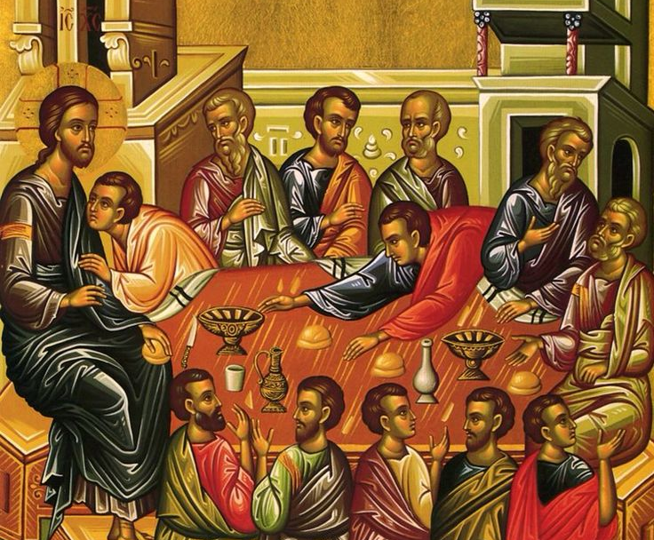
Have We Heard
His Challenge?
“Most assuredly, I say to you, he who believes in Me, the works that I do he will do also; and greater works than these he will do, because I go to My Father.”
John 14:12

Slide 17
Have We Prayed
for Fellow Workers?
“After these things the Lord appointed seventy others also, and sent them two by two ahead of Him into every city and place whither He Himself would come.
“Therefore He said unto them, ‘The harvest truly is great, but the laborers are few; pray ye therefore the Lord of the harvest, that He would send forth laborers into His harvest.’”
Luke 10:1-2

Slide 18
Are We Ready For The Judgment
Together With Our Community?
“We are judged in and part of a community, so we have a responsibility to make our community the right community for Christ… for we share in the judgment that the entire community faces.”
-- Fr Theodore Bobosh
Icon by Fr Luke Dingman

Slide 19
Together We Are
Laos tou Theou: The People of God
You are a chosen race,
a royal priesthood,
a holy nation,
God's own people,
1 Peter 2: 9

Slide 20
Together We Are
Laos tou Theou: The People of God
You are a chosen race,
a royal priesthood,
a holy nation,
God's own people,
that you may declare the wonderful deeds of him who called you out of darkness into his marvelous light.
1 Peter 2: 9

Slide 21
The Church is Hierarchical
“Let the bishop preside in God’s place, and the presbyters take the place of the apostolic council, and let the deacons (my special favorites) be entrusted with the ministry of Jesus Christ….
“You must have one prayer, one petition, one mind, one hope, dominated by love and unsullied joy – that means you must have Jesus Christ. You cannot have anything better than that.”
Epistle to the Magnesians 6-7

Slide 22
We Learn How to Lead in Service From Our Clergy
Bishop: Shepherd and Overseer
Priest/ Presbyter: Sacrifice
Deacon: Service

Slide 23
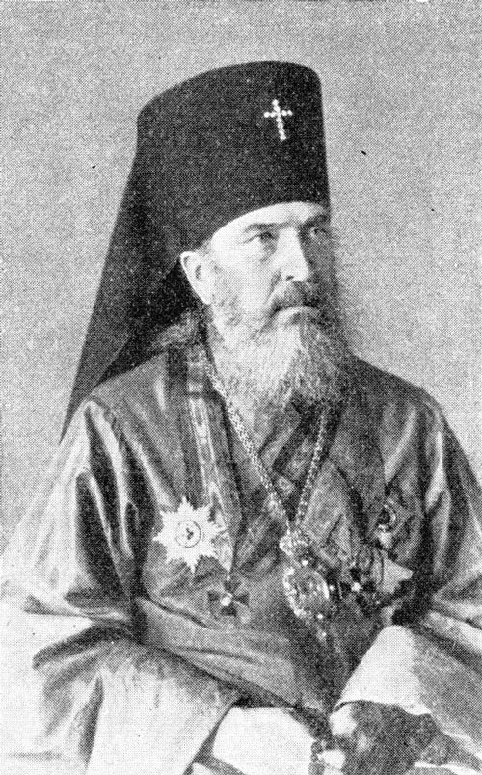
Leadership Lessons from the Bishop
St Nicholas of Japan (1836-1912)
Longed to preach the Word of God
Assigned as Russian consular chaplain
St Innocent: “Learn the language”
Translated NT, Liturgy; learned customs
Encouraged learners to teach others
Church grew from one priest and one convert to over 35,000 Orthodox Christians, 266 communities, 32 priests, 115 catechists
“I am nothing more than a matchstick with which a candle is lit. Afterwards, the match goes out and is thrown on the ground as good for nothing.”

Slide 24
Leadership Lessons of St Nicholas of Japan for the Parish Council
Shepherd: understanding his flock’s culture, language, and values
Getting to know each other’s “story”
Observing age, cultural, and background differences

Slide 25
Leadership Lessons of St Nicholas of Japan for the Parish Council
Shepherd: understanding his flock’s culture, language, and values
Getting to know each other’s “story”
Observing age, cultural, and background differences
Sacrifice: all his waking time and energy to translations and converts
Willing to spend time and resources on evangelization
Giving up “the way we do things” to attract new people
Showing humility to develop and make way for new council members

Slide 26
Leadership Lessons of St Nicholas of Japan for the Parish Council
Shepherd: understanding his flock’s culture, language, and values
Getting to know each other’s “story”
Observing age, cultural, and background differences
Sacrifice: all his waking time and energy to translations and converts
Willing to spend time and resources on evangelization
Giving up “the way we do things” to attract new people
Showing humility to develop and make way for new council members
Service: courage to spread the Word in an antagonistic society
Understanding the “other” and equipping ourselves with the Truth
Spending time with potential inquirers that might not pan out

Slide 27
Leadership Lessons from the Priest/ Presbyter
St John of Kronstadt (1829-1908)
An “ordinary priest of an ordinary parish”
Spent most time in poorest part of town
Gave away his own shoes and money
Founded a House of Industry for the poor
Partook daily of the Body and Blood of Christ
“I die when I am not celebrating the Liturgy”
“He was simply convinced that God cannot refuse to hear the prayer of insistent petition accompanied by the oblation of self” – George Fedotov
Source: W. J. Grisbrooke, Spiritual Counsels of Father John of Kronstadt

Slide 28
Leadership Lessons of St John of Kronstadt for the Parish Council
Shepherd: visiting and caring for his Kronstadt flock
Remembering forgotten members of the parish and contacting them
Welcoming, gathering, and integrating guests and new/old members
Setting the spiritual example for the rest of the community

Slide 29
Leadership Lessons of St John of Kronstadt for the Parish Council
Shepherd: visiting and caring for his Kronstadt flock
Remembering forgotten members of the parish and contacting them
Welcoming, gathering, and integrating guests and new/old members
Setting the spiritual example for the rest of the community
Sacrifice: all his waking time, energy, attention to the poor
Donating time, talent, and resources for the mission of the Church
Giving up personal ego and pride to work with others on the Council

Slide 30
Leadership Lessons of St John of Kronstadt for the Parish Council
Shepherd: visiting and caring for his Kronstadt flock
Remembering forgotten members of the parish and contacting them
Welcoming, gathering, and integrating guests and new/old members
Setting the spiritual example for the rest of the community
Sacrifice: all his waking time, energy, attention to the poor
Donating time, talent, and resources for the mission of the Church
Giving up personal ego and pride to work with others on the Council
Service: working with others to start the House of Industry
Doing whatever tasks need to be done, even menial ones
Collaborating with others for outreach

Slide 31
Leadership Lessons from the Laity
Saints Priscilla and Aquila
Always named in NT as a couple
Tent-makers
Accompanied the Apostle Paul
Provided hospitality
Hosted church in their home
Explained the Word of God
Served and martyred together

Slide 32
Lessons of Saints Priscilla and Aquila for the Council
Shepherd: keeping their family “flock” and their friendship with Paul
Working as a team in the Church
Supporting the Priest and his family via mutual friendship

Slide 33
Lessons of Saints Priscilla and Aquila for the Council
Shepherd: keeping their family “flock” and their friendship with Paul
Working as a team in the Church
Supporting the Priest and his family via mutual friendship
Sacrifice: opening their home to the Church community
Hosting mutual gatherings of Council members and the Priest/family
Engaging with youth gatherings, adult fellowship
Going “out on a limb” to teach and preach without fear

Slide 34
Lessons of Saints Priscilla and Aquila for the Council
Shepherd: keeping their family “flock” and their friendship with Paul
Working as a team in the Church
Supporting the Priest and his family via mutual friendship
Sacrifice: opening their home to the Church community
Hosting mutual gatherings of Council members and the Priest/family
Engaging with youth gatherings, adult fellowship
Going “out on a limb” to teach and preach without fear
Service: being a “fellow-worker” with the Apostle Paul
Discussing seriously vision and mission with Priest within the council
Don’t wait to be asked to serve: ask “how can I help”

Slide 35
How does the Priest Provide Direction & Leadership to Council?
The priest loves and values each council member
as his co-workers and co-leaders in Christ

Slide 36
How does the Priest Provide Direction & Leadership to Council?
The priest loves and values each council member
as his co-workers and co-leaders in Christ
The priest teaches them by the example of the Gospel and the Saints

Slide 37
How does the Priest Provide Direction & Leadership to Council?
The priest loves and values each council member
as his co-workers and co-leaders in Christ
The priest teaches them by the example of the Gospel and the Saints
The priest knows them as shepherd and they know his voice
The priest sacrifices himself for them, especially his ego and pride
The priest serves them by fostering their ministerial vocation

Slide 38
How does the Council respond to the Priest’s Leadership?
The council loves and values him as their leader in Christ

Slide 39
How does the Council respond to the Priest’s Leadership?
The council loves and values him as their leader in Christ
The council cares for his spiritual, emotional and physical health
The council sacrifices their individual egos lovingly speaking the truth
The council serves him by incarnating his priesthood in action

Slide 40
Obedience Must Be Combined With Love In Unity
St Ignatius of Antioch stresses obedience to the clergy (Ep. Trallians)
“[Be] submissive to the bishop as to Jesus Christ”
“Submit yourselves also to the presbytery, as to the Apostles of Jesus Christ”
“All must respect the deacons as they reverence Jesus Christ”

Slide 41
Obedience Must Be Combined With Love In Unity
St Ignatius of Antioch stresses obedience to the clergy (Ep. Trallians)
“[Be] submissive to the bishop as to Jesus Christ”
“Submit yourselves also to the presbytery, as to the Apostles of Jesus Christ”
“All must respect the deacons as they reverence Jesus Christ”
Jesus Christ assures us that the ultimate message of obedience is love
“I do as the Father has commanded me, so that the world may know that I love the Father.” (Jn 14.31)
“If you keep my commandments, you will abide in my love, just as I have kept my Father's commandments and abide in his love.” (Jn 15.10)

Slide 42
The One To Whom Is Owed Obedience Must Sacrifice in Love
St Isaac the Syrian on the gentleness that is required
“Do not reprove anyone for any transgression, but in all things consider yourself responsible….Avoid laying down the law, as you would flee from an untamed lion.”

Slide 43
The One To Whom Is Owed Obedience Must Sacrifice in Love
St Isaac the Syrian on the gentleness that is required
“Do not reprove anyone for any transgression, but in all things consider yourself responsible….Avoid laying down the law, as you would flee from an untamed lion.”
St Gregory Nazianzen paints St Paul’s picture of the perfect pastor
“What is the lesson and instruction he would thus impress upon us? Not to be proud of earthly things, or puffed up by knowledge …. He fights for all, prays for all, is jealous for all, is kindled on behalf of all….

Slide 44
The One To Whom Is Owed Obedience Must Sacrifice in Love
St Isaac the Syrian on the gentleness that is required
“Do not reprove anyone for any transgression, but in all things consider yourself responsible….Avoid laying down the law, as you would flee from an untamed lion.”
St Gregory Nazianzen paints St Paul’s picture of the perfect pastor
“What is the lesson and instruction he would thus impress upon us? Not to be proud of earthly things, or puffed up by knowledge …. He fights for all, prays for all, is jealous for all, is kindled on behalf of all….
“He imitates Christ, who became a curse for us, who took our infirmities and bore our sicknesses; or, to use more measured terms, he is ready, next to Christ, to suffer anything, even as one of the ungodly, for them, if only they be saved.”

Slide 45
Now that we have gone
“Back to Basics”
We can think about
“Process”

Slide 46
Process Recommendations
Adopt a Council Patron Saint whom you wish to emulate

Slide 47
Process Recommendations
Adopt Council Patron Saint whom you wish to emulate
Monthly meeting agenda to:
Hold devotional on spiritual life; connect everything to Christ
Use consent agenda for routine items not needing discussion
Be aware to include everyone’s concerns
Engage everyone in ministry

Slide 48
Process Recommendations
Adopt a Council Patron Saint whom you wish to emulate
Monthly meeting agenda to:
Hold devotional on spiritual life; connect everything to Christ
Use consent agenda for routine items not needing discussion
Be aware to include everyone’s concerns
Engage everyone in ministry
Quarterly priest/ council spiritual retreat
Annual priest/ council mutual expectations retreat
Triennial strategic planning exercise

Slide 49
Process Recommendations
Adopt a Council Patron Saint whom you wish to emulate
Monthly meeting agenda to:
Hold devotional on spiritual life; connect everything to Christ
Use consent agenda for routine items not needing discussion
Be aware to include everyone’s concerns
Engage everyone in ministry
Quarterly priest/ council spiritual retreat
Annual priest/ council mutual expectations retreat
Triennial strategic planning exercise
Ongoing development of new leaders to refresh the council

Slide 50
orthodoxservantleaders.com

Slide 51
Cultivating Vision & Change | Building Effective Parish Leadership Teams | Inspiring Generosity & Stewards | Finance Planning & Management
Learn more https://www.orthodoxservantleaders.com/

